Slide 1
Improving the Decision Making of Active Surgical Robots in Hospitals
- Alina Saduova
Committee Chair: Dr. Eyhab Al-Masri
Committee Member: Dr. Zhiquan (Andy) Shu

Slide 2
OUTLINE
Background
Motivation
Objectives
System Architecture
Evaluation and Results
Simulation (Demo)
Learning Experience (Paper, conference)
Conclusion
Notes:
4 -> motivation +
13-17 -> scenarios and results +
18 -> paper +
19 –> conclusion +
Slides – 1 hour +
Script – 1 hour
Demo – 30 min
Slides 11-12
Breakfast 12-1
Script, demo 1-2:30
Presentation – 3pm, lunch prep

Slide 3
Background
Robot-assisted procedures are still constrained by master-slave relation with a surgeon.
Types of robots:
Passive robot-holders – used to locate tumors in the brain
Semi-active robots – perform narrowly specified tasks (laparoscopic camera)
Active robots – provide haptic feedback for the surgeon, remote control of the robot
Active robots provide surgeons with a greater level of flexibility and control
Notes:
Robots diagnose, make closing sutures, perform surgeries as a slave to the master-surgeon, and even implement simple procedures on their own. Even though it helped many surgeons and patients all over the world, there is still a place to grow for them, such as performing complex surgeries without external help and being an assistant to a surgeon in helping to make the best treatment plan while operating.
Passive robots, which are commonly hand-held devices, are assistive tools that do not actively perform any surgical operations. An example of passive robots is NeuroMate, a commercial robot that helps in locating large brain tumors in the brain and integrates to a planner in neurosurgery [5]. Semi-active robots are ones that allow surgeons to perform a surgical procedure having direct control. That is, semi-active robots can interact directly on the patient’s body with the direct control of an observer or surgeon (e.g. Acrobot Surgical System [6]). Active robots are autonomous and are capable of performing part of surgical procedures (e.g. ROBODOC [7], CASPAR [8]).

Slide 4
Motivation
Key risk factors
Incomplete/missing imaging information
Time pressure
Causes
Lack of training and education
Gap in communication between staff
Result
At least 4000 surgical errors each year
Poor staffing
Human factors
Robots could help surgeons make decision during training and real operations
(Rodziewicz, 2021)
Notes:
consider contextual information collected by the robot to enhance decision-making. Therefore, if robots would not only give the better implementation of certain actions on patient’s body but also help surgeon to make decisions – will certainly increase the quality of surgeries and help saving lives in critical situations and during post-operative time.
Not replace but help

Slide 5
Objectives
Identification of relevant parameters for the surgical procedure.
Design IoT Surgical Robot (IoTSR) Framework of making optimized decisions regarding the next steps in the procedure.
Design different use case scenarios.
Analyze the performance of the 4 different decision-making methods for 3 different surgical operations.
Simulate the approach using multiple test cases and experiments.
Notes:
To improve the decision making of active surgical robots, we present an edge-based self-adaptive Surgical Robot (IoTSR) framework acting as a middleware between patients, surgical robot in an operating room and a surgical team or experts
This allows IoTSR to offload edge-based tasks that are computationally intensive (e.g. AI operations) across other distributed edge nodes discovered within a hospital’s network. Using the built-in sensors, the surgical robot continuously collects data about the patient. This data primarily depends on the operation that is performed.
Therefore, it is imperative to design IoTSR such that it supports multiple-criteria for the decision making process

Slide 6
IoT Surgical Robot (IoTSR) Framework
Parameters:
Attributes for use case 3 (Kawarada, 2000)
3D visual clarity (%)
Bleeding rate (ml)
Distance to portal vein (mm)
Distance to portal venous branch (mm)
Attributes for use case 1 (Kawarada, 2000)
3D visual clarity (%)
Liver removal risk level (%)
Blood vessel exposure or reconstruction (%)
Cancerous spread level (%)
Attributes for use case 2 (Giulianotti, 2018)
Amount of jejunal mucosa (%)
Bile duct diameter (mm)
Estimated blood loss (ml)
3D visual clarity (%)
Notes:
References from 10 and 11
What’s mucosa, Bile duct

Slide 7
IoTSR Optimization Model
Technique for Order of Preference by Similarity to Ideal Solution (TOPSIS):
TOPSIS is a multi-criteria decision analysis method based on the comparison between all the alternatives included in the problem.
Goal: Rank different alternative steps in surgery using multiple evaluation metrics.
Weights | W₁ | W₂ | W₃ | … | W_{n}
Parameters | P₁ | P₂ | P₃ | … | P_{n}
Alternative-1 | X₁₁ | X₁₂ | X₁₃ | … | X_{1n}
Alternative-2 | X₂₁ | X₂₂ | X₂₃ | … | X_{2n}
: | … | … | … | … | …
Alternative-N | X₃₁ | X₃₂ | X₃₃ | … | X_{3n}

Slide 8
IoTSR Optimization Model
TOPSIS with Analytical Hierarchy Process (AHP):
AHP is used in quantifying the weights of decision criteria through pair-wise comparisons
Goal: Rank different decision-making parameters according to the importance between each other by following scale:
1 - equal importance
3 - moderate importance
5 - strong importance
7 - very strong importance
9 - extremely strong importance
 | P₁ | P₂ | P₃ | P₄
P₁ | 1 | 3 | 5 | 7
P₂ | 1/3 | 1 | 1/2 | 1/3
P₃ | 1/5 | 2 | 1 | 1/9
P₄ | 1/7 | 3 | 9 | 1

Slide 9
IoTSR Optimization Model
Preference Ranking Organization METHod for
Enrichment of Evaluations (PROMETHEE II)
The PROMETHEE II method allows one to establish a complete ranking between possible movements based on outranking relations.
Goal: Rank different alternative steps in surgery depending on the leaving and entering outranking flows
Weights | W₁ | W₂ | W₃ | … | W_{n}
Parameters | P₁ | P₂ | P₃ | … | P_{n}
Alternative-1 | X₁₁ | X₁₂ | X₁₃ | … | X_{1n}
Alternative-2 | X₂₁ | X₂₂ | X₂₃ | … | X_{2n}
: | … | … | … | … | …
Alternative-N | X₃₁ | X₃₂ | X₃₃ | … | X_{3n}

Slide 10
IoTSR Optimization Model
Fuzzy Technique for Order of Preference by Similarity to Ideal Solution (Fuzzy TOPSIS):
Fuzzy TOPSIS uses similar logic as of the regular TOPSIS, while the importance of criteria are ranked using the following Fuzzy numbers:
Very Low (1, 1, 3)
Low (1, 3, 5)
Average (3, 5, 7)
High (5, 7, 9)
Very High (7, 9, 9)
Goal: Rank different alternative steps in surgery using multiple evaluation metrics.

Slide 11
Subjective weight generation methods
CRITIC
Entropy
CRiteria Importance Through Intercriteria Correlation
Takes both the contrast intensity and contradictory character of the assessment criteria into account
Avoidance of human factor
(Sahin, 2021)
Avoidance of human factor
Measures degree of differentiation
Higher degree – more information can be derived
(Yuxin, 2020)
Notes:
The greater the difference between the values of elements in a column, the smaller the entropy value of the elements in this column and the larger the entropy weight value.

Slide 12
System Architecture
(A. Saduova, E. Al-Masri, 2021)
Notes:
Citation to the paper

Slide 13
Scenarios
Weights
Implicit
CRITIC
Entropy
Explicit (user defined)
General
Mission - centric

Slide 14
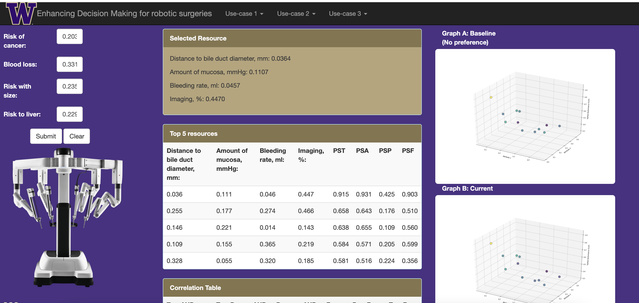
Demo

Slide 15
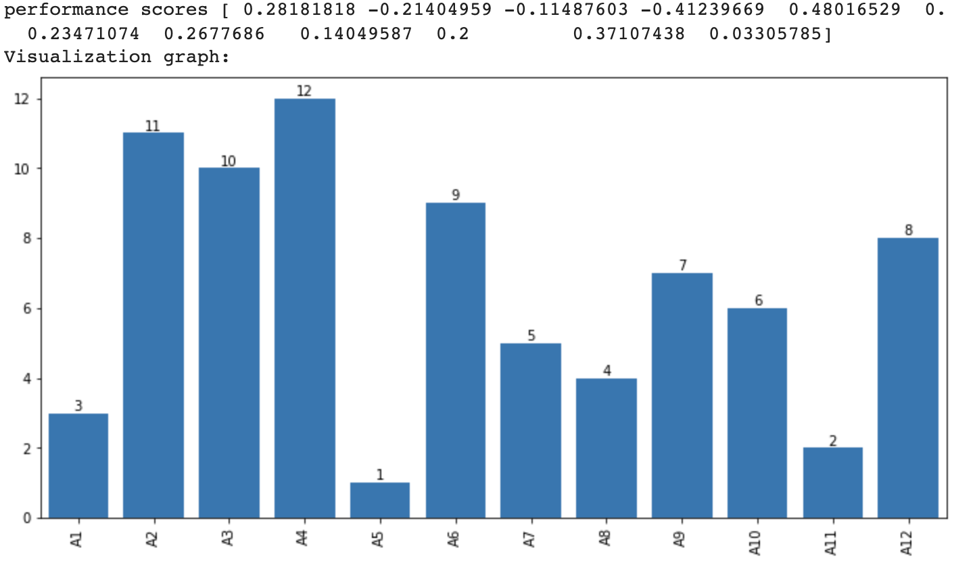
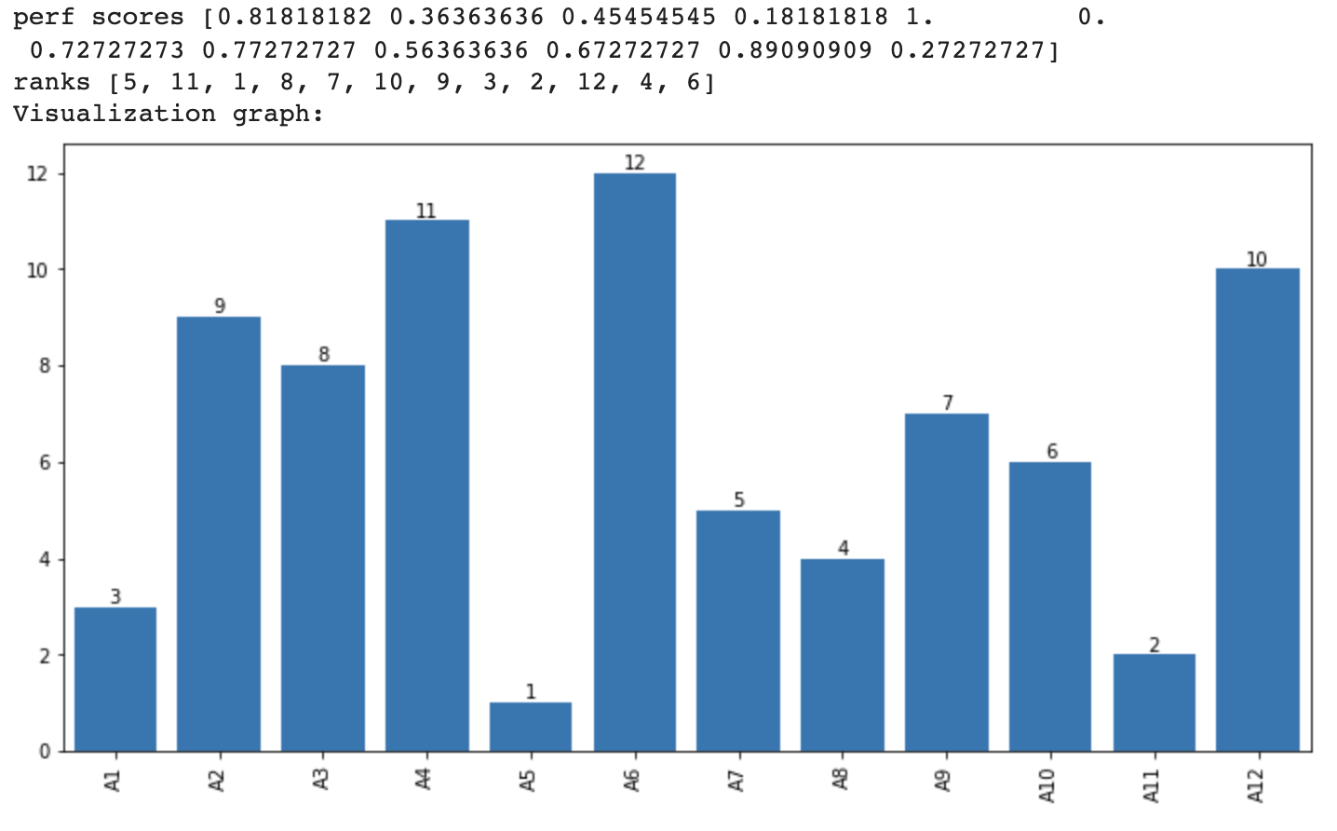
Results, blood loss - centric
Promethee:
TOPSIS

Slide 16
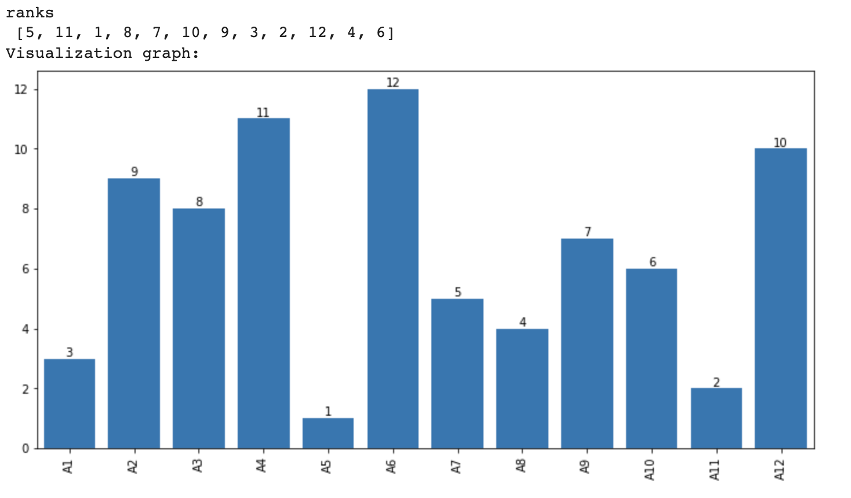
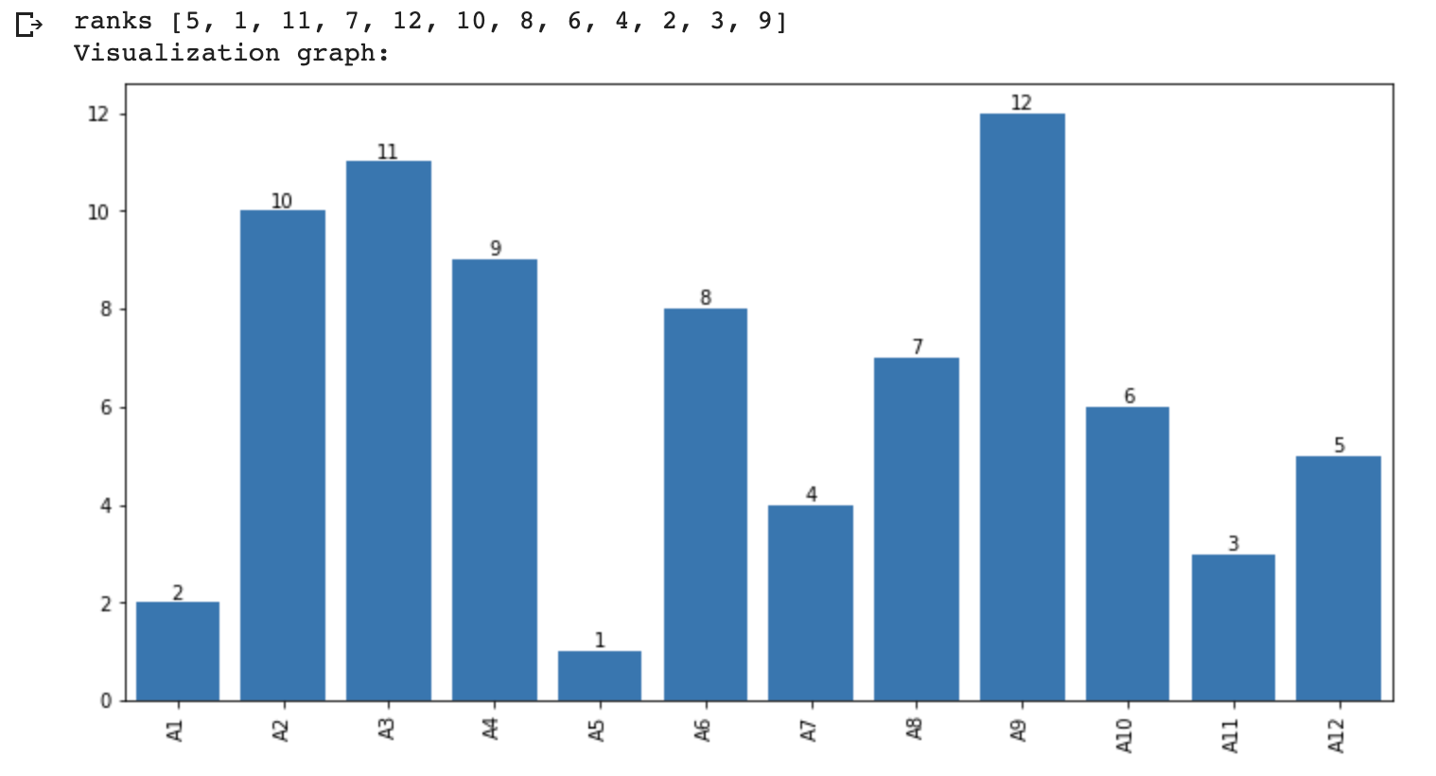
Results, blood loss - centric
TOPSIS with AHP
Fuzzy TOPSIS

Slide 17
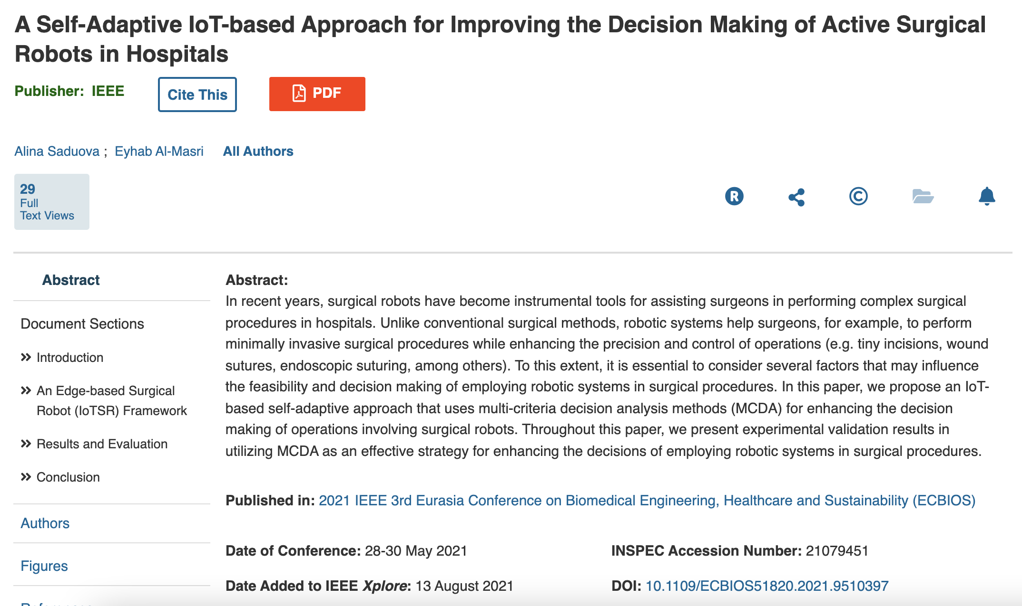
Learning Experience
Application of Multiple-Criteria Decision Analysis (MCDA) technique: TOPSIS, Promethee II, Fuzzy TOPSIS, AHP
Weight generation methods: CRITIC, ENTROPY
Research skills in medical sphere
Data Analysis using Pandas, Matplotlib, Python, Google Collab
Web application development JavaScript, Flask

Slide 18
Conclusion
IoTSR analyzes the datasets based on multiple attributes and ranks them according to the surgeon requirements.
We developed 3 different use cases and validated the correctness of the model by:
Manual judgement tested from existing data & results
Adjusting the weights to witness the right selection of the attribute
The results show that the model strategies select the best alternative of all the available variants.
Future Work: More use cases from different surgeries, additional testing against real surgical steps and vitals

Slide 19
References
Yuxin Zhu, Dazuo Tian, Feng Yan, "Effectiveness of Entropy Weight Method in Decision-Making", Mathematical Problems in Engineering, vol. 2020, Article ID 3564835, 5 pages, 2020. https://doi.org/10.1155/2020/3564835
Şahin, M. A comprehensive analysis of weighting and multicriteria methods in the context of sustainable energy. Int. J. Environ. Sci. Technol. 18, 1591–1616 (2021). https://doi.org/10.1007/s13762-020-02922-7
Kawarada, Y., Das, B.C. and Taoka, H., 2000. Anatomy of the Hepatic Hilar Area: the Plate System. Journal of hepato-biliary-pancreatic surgery, 7(6), pp.580-586.
Giulianotti, P.C., Mangano, A., Bustos, R.E., Gheza, F., Fernandes, E., Masrur, M.A., Gangemi, A. and Bianco, F.M., 2018. Operative Technique in Robotic pancreaticoduod- enectomy (RPD): 17 steps standardized technique. Surgical endoscopy, 32(10), pp.4329-4336.
Rodziewicz TL, Houseman B, Hipskind JE. Medical Error Reduction and Prevention. [Updated 2021 Aug 6]. In: StatPearls [Internet]. Treasure Island (FL): StatPearls Publishing; 2021 Jan-. Available from: https://www.ncbi.nlm.nih.gov/books/NBK499956/

Slide 20


Slide 21
Questions?

